Slide 1
Fun with Frameworks
Beth Schwindt
BC Research School #1
Notes:
Diane Fossey

Slide 2
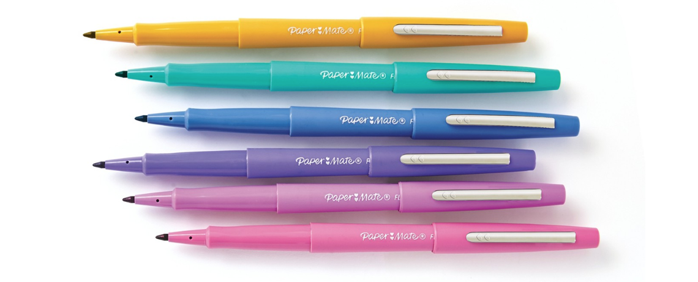
Witty Slide/Intro

Slide 3
Q.
Where do frameworks
come from?

Slide 4
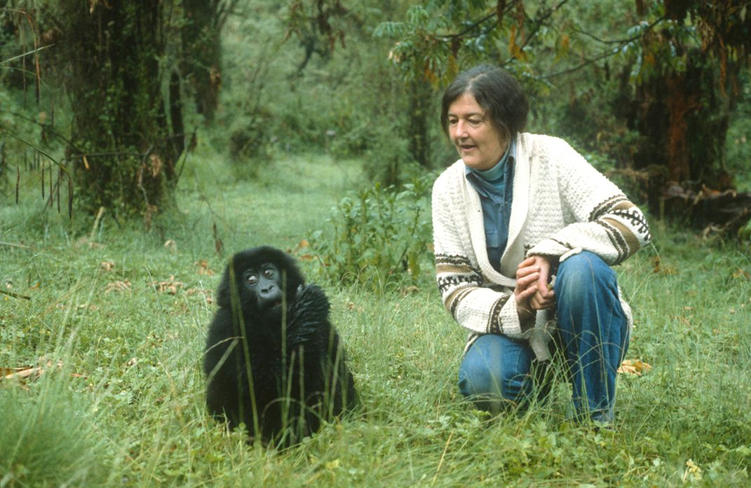
Notes:
Guts --- personas are really the “user” part of a product architecture map. --- When we are good, we map the user needs to the function structure. Always be mapping the user needs to the function structure.

Slide 5
Q.
What can they do for me?

Slide 6
Discovery
Gather a lot of data
Notes:
https://www.nngroup.com/articles/interviewing-users/
30% of usability errors
https://www.qualtrics.com/experience-management/research/determine-sample-size/
95% confident, +/-5% confidence level/margin of error (one variable)

Slide 7
Evaluative
Diagnose + Define “Good”
Notes:
https://www.nngroup.com/articles/interviewing-users/
30% of usability errors
https://www.qualtrics.com/experience-management/research/determine-sample-size/
95% confident, +/-5% confidence level/margin of error (one variable)

Slide 8
POEMS
Overall/Unknown
People
Objects
Environments
Messages
Services/Systems
Inventory Existing
Write Questions
Take Notes
Analyze Results
Notes:
https://www.nngroup.com/articles/interviewing-users/
30% of usability errors
https://www.qualtrics.com/experience-management/research/determine-sample-size/
95% confident, +/-5% confidence level/margin of error (one variable)

Slide 9
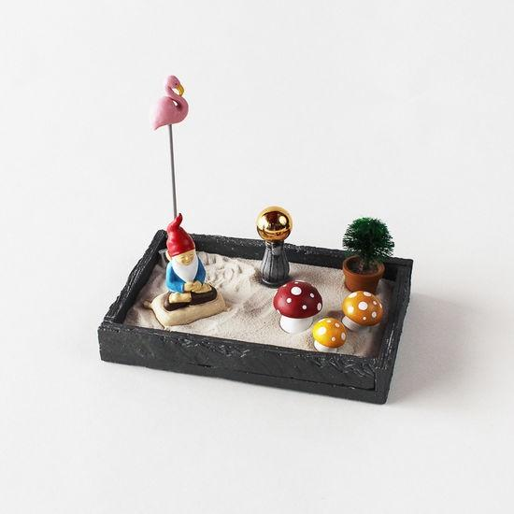
POEMS
Overall/Unknown
People
Objects
Environments
Messages
Services/Systems
Notes:
https://www.nngroup.com/articles/interviewing-users/
30% of usability errors
https://www.qualtrics.com/experience-management/research/determine-sample-size/
95% confident, +/-5% confidence level/margin of error (one variable)

Slide 10
5Es
Process
Entice
Enter
Engage
Exit
Extend
Inventory Existing
Write Questions
Take Notes
Analyze Results
Notes:
https://www.nngroup.com/articles/interviewing-users/
30% of usability errors
https://www.qualtrics.com/experience-management/research/determine-sample-size/
95% confident, +/-5% confidence level/margin of error (one variable)

Slide 11

5Es
Process
Entice
Enter
Engage
Exit
Extend
Inventory Existing
Write Questions
Take Notes
Analyze Results
Notes:
https://www.nngroup.com/articles/interviewing-users/
30% of usability errors
https://www.qualtrics.com/experience-management/research/determine-sample-size/
95% confident, +/-5% confidence level/margin of error (one variable)

Slide 12
Human Factors
Did we design for the full human?
Cognitive
Social
Cultural
Physical
Emotional
Inventory Existing
Write Questions
Take Notes
Analyze Results
Notes:
https://www.nngroup.com/articles/interviewing-users/
30% of usability errors
https://www.qualtrics.com/experience-management/research/determine-sample-size/
95% confident, +/-5% confidence level/margin of error (one variable)

Slide 13

4As -
Who are these people, really?
What do they care about?
Inventory Existing
Write Research Questions
Analyze Results
Take Notes
Notes:
https://www.nngroup.com/articles/interviewing-users/
30% of usability errors
https://www.qualtrics.com/experience-management/research/determine-sample-size/
95% confident, +/-5% confidence level/margin of error (one variable)

Slide 14
4As
What do we know about what people really want?
Ambitions
Anxieties
Attitudes
Actions
Inventory Existing
Write Questions
Take Notes
Analyze Results
Notes:
https://www.nngroup.com/articles/interviewing-users/
30% of usability errors
https://www.qualtrics.com/experience-management/research/determine-sample-size/
95% confident, +/-5% confidence level/margin of error (one variable)

Slide 15
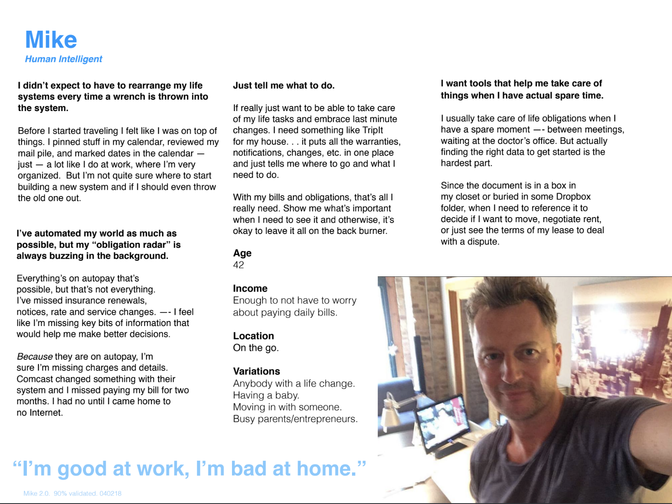
Notes:
5es, AEIOU, 5HFs, POEMS frameworks ---
https://www.epicpeople.org/article_author/rick-robinson/

Slide 16
Thanks!
Questions?

